Slide 1
Security in Embedded Computing
René Burger
Hochschule Bonn-Rhein-Sieg

Slide 2
Table of Contents
Introduction
General Definitions
Key-Algorithms in cryptography
How can communication be secured?
Different kinds of software attacks
Why are embedded devices so different?
Security coprocessors
Hardware attacks

Slide 3
Introduction

Slide 4
Motivation
Today, more and more devices get connected to the internet
Smart home: heating, lighting, home security (IP cams, motion sensors, door locks etc.)
Probably your washing machine and fridge will be accessible via internet in the next years
Many embedded devices are used in nearly every field of technology
Smartphones
BluRay Players/ Smart TV sticks
Also some with high-security requirements
Machines in hospitals, steering of industrial facilities
Cars (Tesla model S: Internet connectivity!!)
→ Security of embedded devices is important in our everyday life!

Slide 5
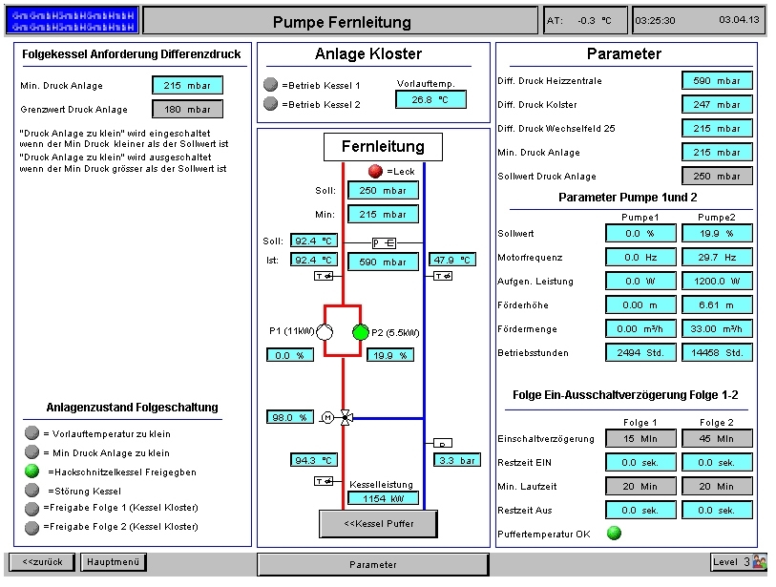
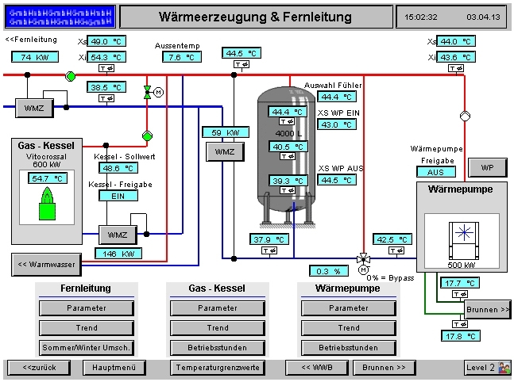
Then we see this:
Did you ever want use to control a pumping station?
Do you want to alter the brewing process of a brewery in Black Forest?
NO PROBLEM: Just use the web interfaces you find from open port scans and try out standard passwords (c’t 11/2013)

Slide 6
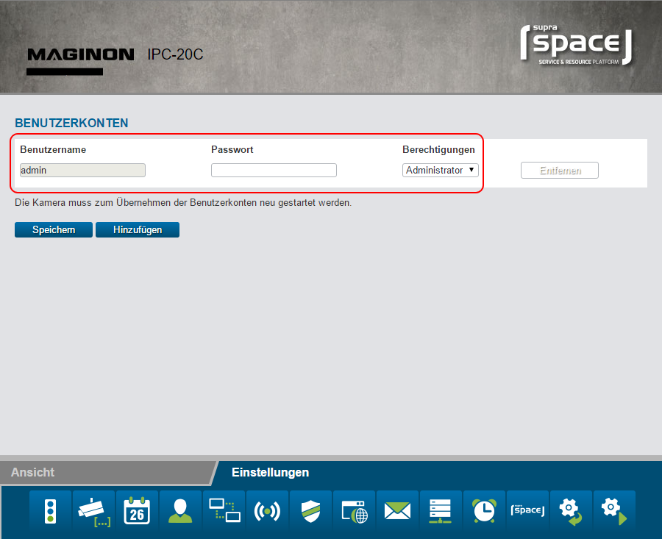
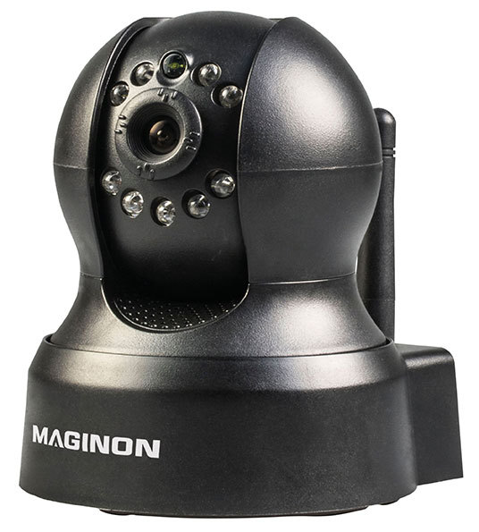
Did you ever want to look into private houses with an IP cam of their owner? Just try the ones that were sold from ALDI in 2015 (heise.de, 01/2016)
Many have not been patched yet

Slide 7
General Definitions of security terms
(from [Quelle TPM 2.0 Buch])

Slide 8
What means security?
Definiton of Security differs from the point of view:
End-User: concerned of his personal data being stored/transported through the internet
Manufacturer: wants to keep the secret of the proprietary firmware on his device
Content provider: wants copy protection of his media (DRM)
A malicious entity could steal your data, impersonate you, or change documents without being detected
also the malicious entity can vary, depending on who wants which information

Slide 9
Secrecy (Datengeheimhaltung)
Preventing an unauthorized observer of a message from determining its contents
Done by encryption of the message
Message: An array of bytes sent between two parties

Slide 10
Shared secret
A value that is known to two parties
Can be
A password
An encryption key

Slide 11
Integrity
An indication that a message has not been altered during storage or transmission
If integrity is not tested, a man in the middle could change the message without the sender or receiver knowing about it
Usually done by HMAC hashes

Slide 12
Authentication
A means of indicating that a message can be tied to the creator
Recipient can verify that only the creator could have sent the message
Can be obtained by asymmetric encryption

Slide 13
Authorization
Proof, that the user (or the device) is permitted to perform an operation
Anti-Replay
A means of preventing an attacker from reusing a valid message
Nonrepudiation
A means of preventing the sender of a message from claiming that they did not send the message

Slide 14
Example: electronic purchase in an online-shop
Message: contains number of items ordered, confidential customer information (credit card number, address…)
Integrity: Message can not be altered in transit (e.g. from 3 items to 300)
Authentication: Proves that the order really came from the buyer
Authorization: Checks that the buyer is permitted to purchase these items
Anti-Replay: prevents the attacker from sending the buyer’s message again to purchase the items multiple times

Slide 15
Key- algorithms in cryptography

Slide 16
Secure Hashes
Cryptographic hash: digests a message of any length into a hash of fixed length
e.g. SHA-256 produces hashes of 256 bits / 32 bytes
Properties of a good cryptographic hash
It is infeasible (really improbable, takes very much time to compute) to construct two different messages with the same hash
It is infeasible to derive the message from a given hash
→ Hashes are building block of many other operations (HMACs, tickets, digital signatures…

Slide 17
HMAC – Message Authentication Code
Keyed hash: secure-hash operation, but mixes in a shared-secret key (HMAC-Key)
Only a party knowing the HMAC-Key can calculate the same hash
Used to check that a user is authorized (because he knows the key) and that the message has not been altered (integrity)
Example:
User sends a message containing a command to a machine, and HMACs the Message with his “authorization code”
Machine knows that the user was authorized and the message is integer

Slide 18
Symmetric-Encryption Algorithms
Uses a symmetric key to encrypt a message
The same key is used to decrypt the message again
Typical symmetric-key-algorithm: AES (advanced encryption standard)
Used to provide secrecy, keeping data secret from all observers and to secure communication
Symmetric encryption does NOT provide integrity or authenticity
To ensure this, you can HMAC the encrypted data

Slide 19
Asymmetric Algorithms
Uses two Keys: one public, one private
In RSA algorithm: private key can encrypt the data, public key can decrypt it and vice versa
Calculating the public key from the private key is relatively easy, calculating the private key from the public key is computationally infeasible
Much slower than symmetric algorithms
Typical asymmetric Algorithms: RSA, ECC

Slide 20
Asymmetric Algorithms - Applications
Signing data:
Owner encrypts data (e.g. a digest of a message) with his private key
Everyone can decrypt it with the public key, and knows only the owner of the private key could have encrypted that data
To share data (usually a symmetric key to start encrypted communication)
Everyone can encrypt the message with the public key, only the owner of the corresponding private key can decrypt the message

Slide 21
How can communication be secured?

Slide 22
How can communication be secured?
Example: Communication between a server and a client (client could be an IOT device)
1st Idea: Just use asymmetric encryption
Client uses the server’s public key to encrypt the message, only the server will be able to read the plaintext
Server can use the client’s public key to encrypt the message so only the client can decrypt it
1st Problem: Asymmetric encryption is really slow
Solution: use asymmetric encryption only to exchange a symmetric key
After key- exchange the communication is encrypted with the shared-secret symmetric key

Slide 23
How can communication be secured?
2nd Problem: How do we know that the public key is really belonging to the wanted server??
Secrecy won’t be preserved if you encrypt a message with the attacker’s public key
Man in the middle (MITM) attacks work like this: (here, the client wants to send a message to the server)
The MITM sends the client his public key (instead of the server’s) and encrypts the message received by the client
Now he has the message in plaintext and can alter it in the way he wants
He then encrypts the altered message with the server’s public key and sends it to him
No one knows that the message has been altered
We need certificates to ensure, that a key really belongs to its owner
If the public key of the server is certified, and the client sends a symmetric key to the server encrypted by this public key, a secure communication is obtained

Slide 24
How does digital certification work?
A Certificate confirms, that a public key really came from whom it was supposed to come from
A message (encrypted with the public key) really can only be decrypted by the declared owner
A Certificate includes
The public part of the key being certified
Attributes of that key
This is then signed by a certificate authority (CA)
Certificate is encrypted with the CA’s private key
Can be decrypted by the (well-known) CA’s public key

Slide 25
How does digital certification work?
The CA’s public key can also be certified by another CA’s key → forming a certificate chain
At the end, the chain terminates at a root certificate, that is conveyed to a verifier and that is trusted without cryptographic proof

Slide 26
Different kinds of software attacks
Notes:
Until now, learned about general principles of security and how communication can be secured
Now, I’ll show you different methods to attack an embedded system via software

Slide 27
Exploiting a flaw in the design
Discovering bugs and security gaps in the firmware of a system
For example
An algorithm being used in the system, that is not safe anymore (SHA-1)
A security gap in the web interface of a router or printer
Unhandled variable overflows (C )

Slide 28
Using Brute Force
Trying any combination of a key or password many times, until you have successfully found the right one
A good cryptographic algorithm should be “computationally infeasible
It takes an impractical amount of time for trying every possible combination
Brute Force attacks won’t success
Many passwords can be cracked by brute force attacks
A human has to be able to remember the password
it’s often NOT a random combination of Characters but contains words that can be found in the dictionary
“Good” attackers first try dictionary words, or combinations of words and numbers, special characters and so on
→ Brute force attacks are often successful when trying to crack passwords

Slide 29
How are embedded devices different from normal computers?

Slide 30
Embedded Systems have slower processors
It is more difficult to implement safe cryptographic systems, because they often need a relatively high computing performance
Embedded Systems can’t be easily patched or updated
Have you ever updated your router?
Many parts of a system can’t be patched, because many drivers or other components of a system only exist as a “binary blob”
→ even if an OS is updated, underlying systems could have security gaps that often can’t be closed
Old chips often are being used for a long time
If a security gap is discovered in an older chip, no one will be trying to fix it
Even if you could patch the gap, maintaining older chips is not a priority

Slide 31
→ The security of an embedded system has to be considered in the design cycles. It is really hard to patch an embedded system after it has been deployed.

Slide 32
TPM and HSM: Centers of Security
Notes:
One example of a security System, that can be considered to being used in an embedded system: TPM

Slide 33
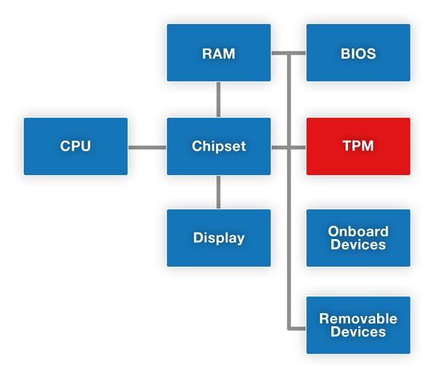
TPM
TPM means “trusted platform module”
TPM Module is a chip mounted on the mainboard of a device
Used to perform cryptographic tasks
A TPM can
Store and manage keys
Perform cryptographic computations
Store and manage certificates
Generate random numbers
→ Useful to generate new keys

Slide 34
Cases where a TPM can be very useful
Identifying a machine - not by their MAC or IP address, but by security identifiers
For access to networks
To authorize a payment or to allow an action only authorized machines are allowed to execute
Encryption
A TPM can encrypt and decrypt (so manage) keys for the encryption of files on the hard drive or to decrypt files that the system got from another device
Full Disk encryption (like BitLocker on Windows Systems with a TPM)
Encryption of Passwords (Password Manager) or other Data
Checking if the Boot Sequence has not been compromised (by using PCR values)

Slide 35
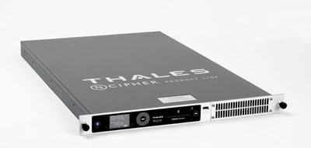
HSM
HSM: Hardware Security Module
External Module - in a PC or used for an entire Network
Also used for cryptographic processing and key- management (in large numbers)
Is also protected against tampers like bus probing, (attacks against the hardware) not only software attacks
Mostly used in very-high security environments like bank servers

Slide 36
Differences TPM/HSM
TPM: Small onboard module with very low cost-factor
Mostly used for authentication and to manage a small amount of keys/certificates
Only used on a single device
HSM: Bigger dedicated module, as extension of a PC, Server or Network
Used to very securely manage keys and certificates (tamper-resistance)
Sometimes also used for high-performance cryptographic computations

Slide 37
Hardware attacks:

Slide 38
Hardware attacks
Systems can not only be compromised with software, but also with hardware methods (and expensive equipment and sophisticated techniques):
Invasive attacks:
Probing inter-component communication, e.g. to read out memory
Reverse-engineering
Access to the internals of a device and the ability to manipulate and interfere with the system is needed
Non-invasive attacks
Timing-attacks
Power analysis
Electromagnetic analysis
Try to detect what a component is computing, depending on which step (of a cryptographic algorithm) it executes, it draws different currents, takes more time or emits different electromagnetic fields

Slide 39
Short conclusion:
Security gaps in embedded systems are really hard to patch
It’s a real problem: Many IOT devices are vulnerable and easily accessible through the Internet
Systems can be successfully secured, but only, if:
Security is considered during the design process of a device.
You can’t change much after release!

Slide 40

Thank you for listening!

Slide 41
Sources
Security Risks of Embedded Systems, Bruce Schneier, 09.01.2014, accessed on 11.08.2016 https://www.schneier.com/blog/archives/2014/01/security_risks_9.html
A Practical Guide to TPM 2.0, Will Arthur, David Challener, Kenneth Goldman, 2015
Computer Organization and Design, David A. Patterson, John L. Hennessy, 2014 Elsevier Inc.
Security as a New Dimension in Embedded System Design, Paul Kocher et al, DAC 2004, June 7–11, San Diego, California, USA, pages 753-760

Slide 42
Picture Sources
https://upload.wikimedia.org/wikipedia/commons/7/7c/NShield_Connect_45_left.jpg
http://electronicdesign.com/site-files/electronicdesign.com/files/archive/electronicdesign.com/content/content/74661/74661_fig1.jpg
http://www.heise.de/newsticker/meldung/Verwundbare-Industrieanlagen-Fernsteuerbares-Gotteshaus-1902245.html
http://www.heise.de/security/meldung/IP-Kameras-von-Aldi-als-Sicherheits-GAU-3069735.html

